Slide 1
Microtesting How we set fire to the testing pyramid while maintaining confidence
Rob Moore
Principal Consultant, Readify
Matt Davies
Lead Consultant, Readify
Notes:
(Rob to start)

Slide 2
Why microtesting?
Because we wanted to be part of the cool club
Because we wanted to harness our inner hipster
Because we have been writing less tests,
but getting more out of it
Notes:
(Rob)
Let’s get the burning question out of the way…
On a more serious note: We’ve been finding that with the testing strategies we’ve been using lately we’ve been writing less tests and getting more out of it.

Slide 3
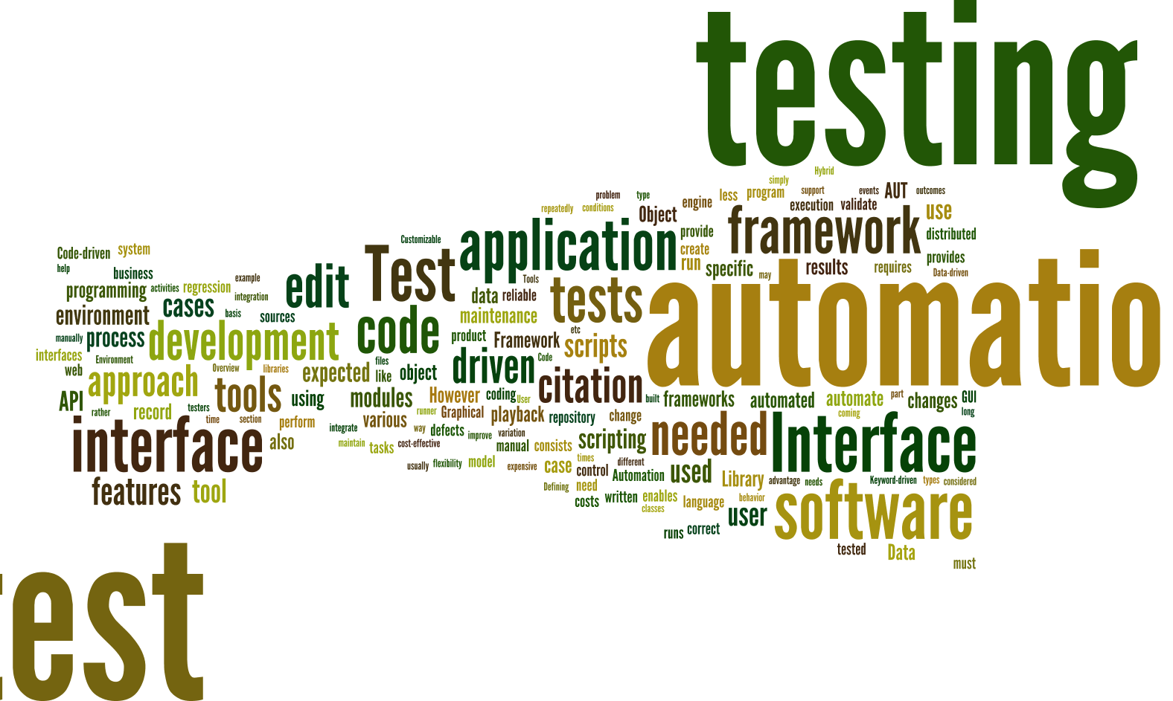
Notes:
(Matt)
Created by piping http://en.wikipedia.org/wiki/Test_automation into http://www.wordle.net/
As consultants we get to move within a number of different projects and industries.
Seen a lot of approaches over the last few years and seen what a lot of companies have done these
Experimented with a number of different approaches ourselves
Done a lot of research into what people are saying and doing

Slide 4

Notes:
(Matt)
http://en.wikipedia.org/wiki/Landfill
We’ve seen (and written) some awful, awful test code
Made our fair share of mistakes and learned a lot

Slide 5
Theory
(sorry)
p.s. don’t worry, we promise we will deliver and burn the testing pyramid – keep an eye out for it
Notes:
(Matt)
In our dedication to improving our testing, we’ve made an number of realisations and we thought it would be helpful to explain these before we go into our current approach.

Slide 6

Speed
?
vs confidence
Notes:
(Rob)
https://www.flickr.com/photos/davidvillarreal/8732245026/
Speed vs confidence
By speed we mean speed of feedback – how quickly do we get feedback as to whether or not the codebase is ok
Confidence – how much certainty do your tests give you that your software is okay

Slide 7
* Ignoring other factors – this is just looking
at speed and confidence
Speed
“unit” tests
real database calls
UI testing
Manual testing
Confidence
Notes:
(Rob)
Automated or UI testing – all other considerations aside (human error, reliability etc) those two forms of testing take a lot of time to run but give you a lot of confidence the system is working because they act as a real user and exercise the entirety of the system as a user would.
Unit tests – super quick feedback but you aren’t exercising the system as a user is – so you aren’t as sure that all the pieces are working together correctly.

Slide 8
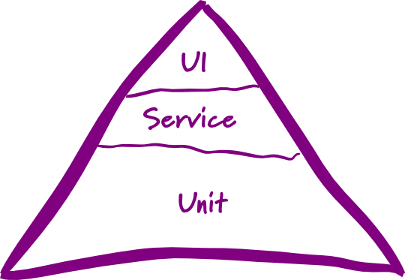
Testing pyramid
☹
Notes:
(Matt)
http://martinfowler.com/bliki/TestPyramid.html
Who cares what type of test you are writing?
---
This is the testing pyramid that you probably first heard about at uni – you have a breakdown of tests that looks something like this:
Most organisations we go into either have limited testing, or have an approach based on something like this. We see this everywhere.
Mostly low level unit tests
A smaller of number of service level or integration tests
An even smaller number of UI or system level tests
---
Problems: You have to care about the type of tests rather than what confidence you’re getting from them
Doesn’t take into account speed vs confidence
One-size-fits-all approach for all your projects that doesn’t give you the flexibility we feel you need across projects
Raise your hand if you’ve ever had a heated discussion about whether or not a test is a unit or an integration test

Slide 9
Jimmy Bogard’s testing pyramid
😐
Slow as
hell
Slow
Fast
Notes:
(Rob)
https://vimeo.com/68390508
Jimmy Bogard presented an alternative testing pyramid in his Holistic Testing talk at NDC Oslo in 2013.
Jimmy provides a breath of fresh air when throwing away the testing pyramid (and all the conflicting definitions of unit, integration, etc. tests) in favour of a pyramid that has a small number of “slow as hell tests”, a slightly larger number of “slow” tests and a lot of “fast” tests.
This is great as it helps us start to focus on something important about the tests – the speed of feedback – but doesn’t go far enough in my opinion since it doesn’t take confidence into account and is still a one-size-fits all strategy.

Slide 10

Our testing pyramid
☺
Notes:
(Rob)
BURN IT TO THE GROUND!!
(Matt)
We fundamentally disagree with the concept of a testing pyramid – as we’ve previous said, it’s too rigid and doesn’t you offer any flexibility between projects.

Slide 11

Our testing pyramid
☺
Notes:
(Rob)
BURN IT TO THE GROUND!!
(Matt)
We fundamentally disagree with the concept of a testing pyramid – as we’ve previous said, it’s too rigid and doesn’t you offer any flexibility between projects.

Slide 12
“The ultimate goal here is to ship code it’s not to write tests; tests are just a means to the end of shipping code.” “I can have 100% code coverage and have noone use my product and I can have 0% code coverage and it’s a huge success; there is no correlation between the two things.”
Jimmy Bogard
Confidence, rather than coverage, is key
Notes:
(Matt)
Quoted from his Holistic Testing talk at NDC 2013.
https://vimeo.com/68390508

Slide 13
So, how do we decide on a testing strategy then?
Notes:
(Rob)

Slide 14
“Challenge yourself to start simple then inspect and adapt”
Notes:
(Rob)

Slide 15
Setting a testing strategy
Challenge yourself to set a minimum confidence level that is as low as possible
Create a testing strategy that meets that confidence level as fast as possible
Adjust the testing strategy over time based on observations (inspect and adapt)
Notes:
(Matt)
Go back to original point on confidence.
1. Most stakeholders will say 100% confidence but that actually means you’ll never get anything shipped out the door. Being pragmatic, we actually want to challenge ourselves to set our confidence level as low as possible for our business needs. in combination with techniques like continuous delivery, we can optimise our testing strategy to be able to react quickly and efficiently to mistakes that do happen.
2. Increases agility and supports CD
3. Your first attempt at this doesn’t have to be right – but it should be simple.
How many bugs are getting to production?
How fast is your team delivering features?
How confident or scared are you when your product is pressing the button to deploy to production?

Slide 16
Is that an oversimplification?
Yes and no.
Notes:
(Rob)
So you might ask – Is that a simplification? Surely you don’t use one type of test (the fastest possible for a confidence level) across your whole app.
[Reveal]
Yes and no.
Confidence level needed will likely change across different parts of the application.
But, we typically start with a broad brush testing strategy and let the inspect and adapt cycle run it’s course. Besides, in most of the apps we work on the majority of the application will be very similar, and then a few parts of it will be “special” and need different treatment. That’s where the inspect and adapt bit comes in to save the day.

Slide 17
Enterprise Grade Testing™
Keep it nimble
Make it per-project
Actually change it
Notes:
(Rob, Matt)
So, because we work for enterprises, we need enterprise-driven right?
We need to set our strategy, show it at CAB and then apply it synergistically across the organization so they are all consistent.
Then we can hire a separate team of testers to roll out the testing strategy across all teams and keep the developers honest because we don’t trust them…
NO. Just stop. Srsly.

Slide 18
What testing strategy have we found effective?
Notes:
(Matt)
There’s a particular style of testing that we’ve generally settled on in projects we’ve worked on in the last year which has worked well for the type of application we’ve been working on.

Slide 19
Context
Small to Medium line-of-business apps
Many industries: education, telecomm., financial
Relatively small proportion of complex code
Not real-time / life-or-death
Using continuous delivery
Mixture of AngularJS, Xamarin and ASP.NET
Notes:
(Matt)
Another note is that we will inspect and adapt this testing strategy throughout a project.

Slide 20
Subcutaneous tests
One-level below the UI e.g. MVC controller
Full stack of production dependencies wired in
Application-owned datasources wired in
External dependencies mocked out
Good speed/confidence balance between all UI tests and all “unit” tests
Notes:
(Rob)
A major part of the strategy that we have been using involves a technique called Subcutaneous Tests

Slide 21
Example testing strategy
Subcutaneous tests for ASP.NET MVC/AngularJS controllers, AngularJS directives and Xamarin view models
In-memory full stack HTTP server requests for ASP.NET Web API
Small, but judicious use of convention tests, route tests, integration tests, “unit” tests, end-to-end tests and UI tests
Notes:
(Matt)

Slide 22
What about “unit” tests?
(and why do you guys keep putting unit in quotes!?)
Notes:
(Rob)

Slide 23
Implementation tests (“unit” tests)
In-memory, in-process, low-level, implementation-focussed
Lightning fast, but lower confidence
Inhibits ability to safely/painlessly refactor
Important tool in the right situation
Useful to drive impl/support of complexity
Decision point – throw away or keep?
Notes:
(Rob)
Are we saying we never do low-level unit tests? No.

Slide 24
Examples
We typically write C#.NET and JavaScript
Examples we are showing will be in C#
Applies to all languages though – you just need to find/write the libraries to support it
Notes:
(Matt)

Slide 25
Demo Implementation unit tests vs subcutaneous test
Notes:
(Rob)
https://gist.github.com/robdmoore/00f99ac3a9053d200768

Slide 26
Subcutaneous test advantages
Testing behaviour → acceptance criteria → ATDD, executable specification
High amount of confidence
Reasonably fast without the fragility of UI tests
Refactoring friendly ☺
Less: tedious mocking code
Notes:
(Matt)
Recap: run through really quickly as we should have covered most of these in the demo.

Slide 27

Subcutaneous test disadvantages
http://bit.ly/robdmooretestingseries
Notes:
(Rob)
https://www.flickr.com/photos/eschipul/4160817135
Not a silver bullet, there are some disadvantages and some limitations you need to be aware of. There are ways of working around or dealing with them though, some of which we will cover in the last part of our talk, others are covered in Rob’s blog posts via the link.

Slide 28
What techniques do we use to make subcutaneous testing easier / more maintainable?
Notes:
(Matt)

Slide 29
Behaviour Driven Tests
Confidence
Focus
Easy to read and write
Tip: If you’re using .NET, look into BDDfy
Notes:
(Matt)

Slide 30
Demo Bddfy / class per scenario
Notes:
(Rob)
https://gist.github.com/robdmoore/00f99ac3a9053d200768

Slide 31
Driving tests via DI container
Helps avoid implementation details
Ensures production code paths
Easy to selectively provide mocks
Tip: Use child lifetime scopes to isolate test runs and incur container startup cost once only
Notes:
(Matt)

Slide 32
Avoiding mocks / Hand-rolling
Avoids implementation details
Only mock external dependencies
Hand-rolled mocks – make mocking painful
Allow behaviour to be codified
Tip: Create standard request/response pairs for APIs as a cross-cutting testing concern
Notes:
(Matt)

Slide 33
Demo Hand-rolled mock example
Notes:
(Matt)

Slide 34
Approval Tests
Test HTML / JSON / XML / text / images etc.
Use human brain
Avoid tedium of assertions
Pin down complex behaviour quickly and easily
Get a nice diff view when things change
Tip: Available in a bunch of languages
Notes:
(Rob)

Slide 35
Object Mother / Test Data Builder
Two powerful patterns that complement
Improves consistency, clarity of intent, tests-as-documentation, readability, maintainability
Allows you to simplify complex data setup
Tip: If you are using .NET check out TestStack.Dossier

Slide 36
Question to ask yourself: Are you happy with amount of effort, overall confidence and speed of feedback?
Notes:
(Matt)
Don’t ask this just once – continually ask yourself this.

Slide 37
Thankyou! Questions?
http://bit.ly/microtesting
Matt Davies
Lead Consultant, Readify
@mdaviesnet
Rob Moore
Principal Consultant, Readify
@robdmoore

Slide 38
Further reading
http://robdmoore.id.au/blog/2015/01/26/testing-i-dont-even/
http://robdmoore.id.au/blog/2013/05/26/test-data-generation-the-right-way-object-mother-test-data-builders-nsubstitute-nbuilder/
http://robdmoore.id.au/blog/2014/01/23/test-naming-automated-testing-series/
https://vimeo.com/68375232
https://vimeo.com/68390508

